Slide 1


AUTOMATIC ATTENDANCE VIA FACE RECOGNITION
Enhancing Efficiencu and Accuracy in Attendance System
Presented By:
Jiya Patel
Gopesh Jha
Jiya Chaudhari
page 01

Slide 2
INTRODUCTION
📌 What is Attendance via Face Recognition?
An innovative system that uses facial recognition technology to automatically record attendance, eliminating the need for manual processes.
🧠 Why It Matters:
Traditional methods (roll calls, ID cards, biometric touch) are slow and prone to errors or misuse.
Face recognition provides a contactless, efficient, and secure solution.
🚀 Growing Relevance:
With advancements in AI and computer vision, this technology is being increasingly adopted in schools, colleges, and corporate offices for smarter management.
page 02

Slide 3
OBJECTIVE
🎯 Main Objectives of the System:
To automate the attendance process using facial recognition technology.
To reduce errors and eliminate proxy attendance.
To provide a contactless and efficient method suitable for classrooms, offices, and events.
To integrate AI and computer vision for real-time monitoring and reporting.
To maintain an accurate digital record of attendance in a secure database.
page 03

Slide 4
HOW IT WORKS?
👁️‍🗨️ Step-by-Step Process:
1. Face Detection
A camera captures real-time images or video of individuals.
The system detects faces using algorithms like Haar Cascade or HOG.
2. Face Recognition
Detected faces are compared with a pre-registered database using deep learning models (e.g., FaceNet, OpenFace).
Unique facial features are extracted as embeddings.
3. Identity Matching
The system matches the live face data with stored profiles.
If a match is found, the identity is confirmed.
page 04

Slide 5
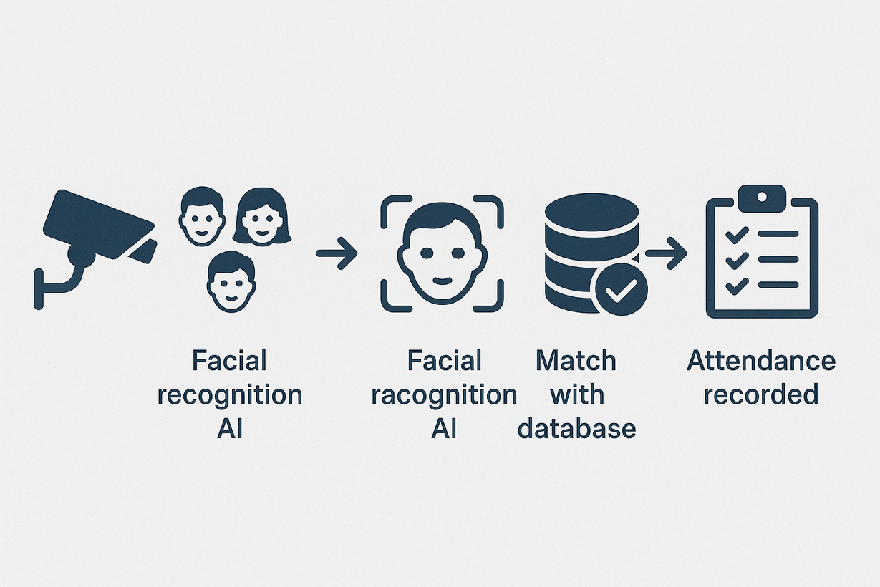
4.Attendance Marking
Once verified, the system automatically logs attendance into the database.
Timestamp and additional metadata (location, image) may also be stored.
5.Real-Time Reporting
Admins can access dashboards for live attendance reports and analytics.
page 05

Slide 6
TECHNOLOGIES USED
🧠 Software & Libraries:
Python – Core programming language for building the system.
cv2: OpenCV library for computer vision tasks, including image processing and face detection.
numpy: Library for numerical operations, used for handling arrays and matrices.
os: Provides functions for interacting with the operating system, such as file and directory management.
urllib.request: Used for downloading files from the internet.
csv: For reading and writing CSV files, which are used to record attendance.
datetime: For handling date and time operations.
pickle: For serializing and deserializing Python objects, used to save and load the trained model and data.
cv2.face: A submodule of OpenCV that provides the LBPH face recognizer.
page 06

Slide 7
KEY FEATURES
DNN-based robust face detection.
LBPH-based efficient face recognition.
Augmented training for better recognition accuracy.
Attendance CSV creation and duplicate checking.
Interactive user interface with keyboard controls.
page 07

Slide 8
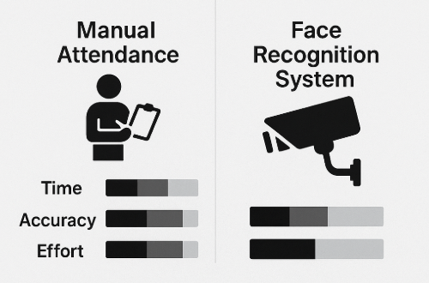
ADVANTAGES
Key Benefits of Face Recognition-Based Attendance:
Contactless & Hygienic
Time-Saving
Accurate & Reliable
Eliminates Proxy Attendance
Real-Time Monitoring
Easy Integration
page 08

Slide 9
CHALLENGES
⚠️ Challenges in Implementing Face Recognition for Attendance:
Lighting & Environmental Conditions
Poor lighting or camera angle can affect detection accuracy.
Face Occlusion
Masks, glasses, hats, or hairstyles can interfere with recognition.
Privacy Concerns
Requires storage of biometric data, raising ethical and legal concerns.
Initial Setup & Cost
Requires high-quality cameras, processing systems, and training datasets.
Scalability
System performance may drop with a large number of users if not optimized.
False Positives/Negatives
Potential errors in recognition can affect reliability and trust.
page 09

Slide 10
APPLICATION
📍 Where Face Recognition-Based Attendance Can Be Applied:
🏫 Educational Institutions
Schools, colleges, and universities for student attendance.
🏢 Corporate Offices
Automated employee check-in/out systems.
🎤 Conferences & Events
Register and track attendees without manual check-ins.
🚪 Secure Area Access
Restrict entry to labs, server rooms, or other sensitive areas.
🏥 Healthcare Facilities
For staff and patient check-in, reducing touchpoints.
page 10

Slide 11
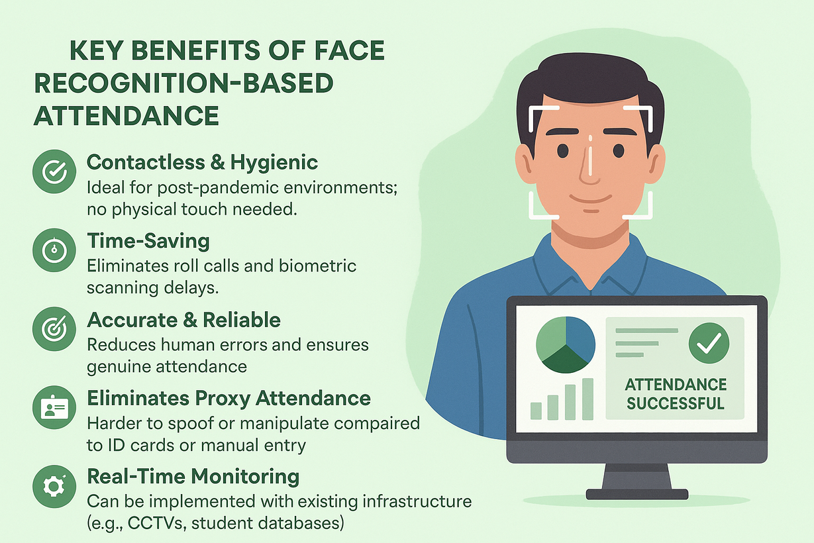
CONCLUSION
📝 Summary:
Face recognition technology provides a modern, contactless, and efficient solution for automating attendance.
It saves time, improves accuracy, and prevents proxy attendance, making it ideal for educational, corporate, and public settings.
Despite a few challenges like lighting and privacy concerns, the system offers significant potential for smart and secure attendance management.
🌐 The Future:
With ongoing advancements in AI and facial recognition, such systems will become more accurate, scalable, and widely adopted in various industries.
page 11

Slide 12
THANK YOU!
page 12

